Slide 1
Rules for Good Scientific Plots

Slide 2
Rules for a Good Scientific Plot
Axis Labels
Appropriate font and line size (and sans font)
Include units
Be descriptive, or use symbols defined nearby
Axis tick marks and tick labels
Appropriate font size (and sans font)
Appropriate significant figures
Appropriate number of labels (typically 4-6 per axis, but can vary depending on the size of the plot)
Limit to relevant values (i.e. don’t’ exceed 1 for mole fraction, if the relevant temperature rang in 200-300 °C, don’t go from 0-300 °C.)
Use somewhat normal increment sizes (1 not 1.25 for example)
(My preference) Don’t use grid lines, they just make the plot busy.
Use black (not excel’s gray) for axis lines and include a plot area border.
Legends and curve labels
Generally the legend should be in the plot area, not outside the plot. If there are many lines though, it can be outside the plot area.
Labeling individual curves can be a good tool.
Don’t have a legend if there is only 1 curve.
Plot Area
Should generally be somewhat squarish. Can deviate a little to better fill space or better present data.
Remove plot border (not the border around the data area, but the light gray border excel puts around the plot when copied into word or power point).
Comparisons with other data sets
Comparisons should almost always be on the same plot.
Split up if there are too many lines on a single plot for it to be readable.
Replot data from other sources, don’t just copy images. (DataThief)
Choose a consistent method of differentiation curves form different sources or under different conditions. (Dashed vs solid lines, open vs closed symbols, light vs dark, etc.)
Colors and curve differentiation
Be consistent. (Don’t completely change your symbol or line style halfway through your list of curves without reason, use the same size symbols for everything).
Use filled and open symbols.
If filled, don’t use a different outline color.
(My preference). I think excel’s default colors are ugly. I like to go with a color scheme that goes black>red>blue>green>orange>purple. 6 colors is usually enough.
Be consistent with the meaning of each color or symbol type or line type.
Yellow is often hard to read.
If the lines are not simply connecting data points, then they should represent a smooth function (i.e. a fit, or an equation of some kind). Discrete data points should be plotted as points.
Captions and Titles
In reports, captions are not optional and should be descriptive but not very interpretive. Presentation should generally not include captions. Give conditions of the data shown (T, P, flow rate, whatever else is relevant). Titles are optional.
Include a citation for any data plotted that you did not generate in the caption for a report, or near the plot (or in the bottom corner of the slide) in a presentation.
Be consistent!
Don’t trust defaults!
Make your plot as understandable as possible with as little effort as possible.

Slide 3
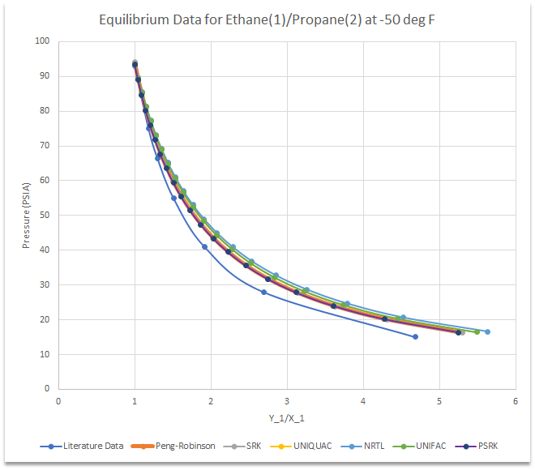
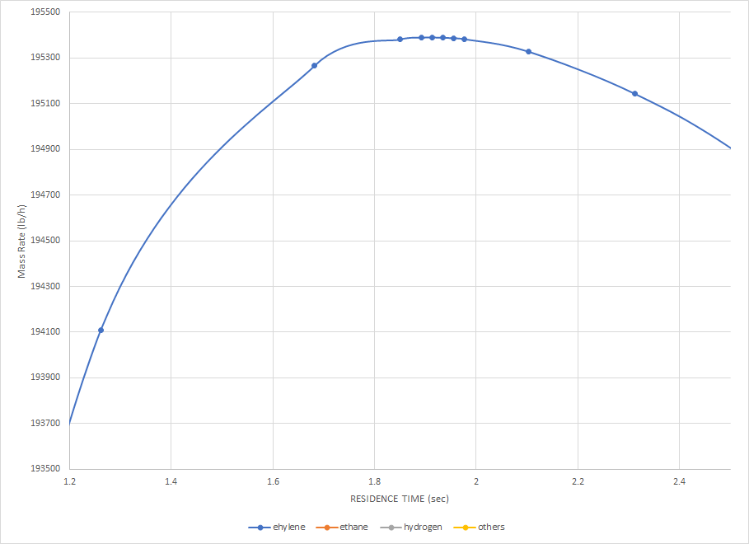
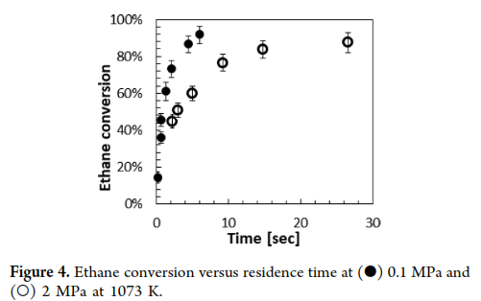
Rules for a Good Scientific Plot
Axis Labels
Appropriate font size (and sans font)
Include units
Be descriptive, or use symbols defined nearby
Saldana, M. H., et al. https://doi.org/10.1021/acs.energyfuels.6b01752

Slide 4
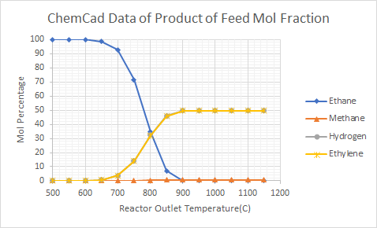
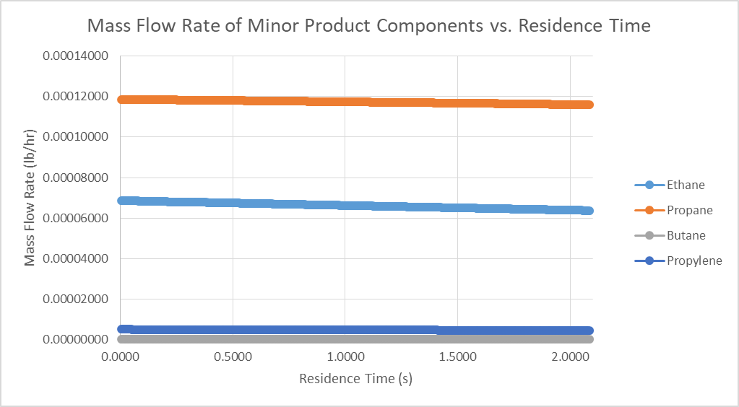
Rules for a Good Scientific Plot
Axis tick marks and tick labels
Appropriate font and line size, generally a bit larger in a presentation (and sans font)
Appropriate significant figures
Appropriate number of labels (typically 4-6 per axis, but can vary depending on the size of the plot)
Use somewhat normal increment sizes (1 not 1.25 for example)
(My preference) Don’t use grid lines, they just make the plot busy
Use black, not gray, for axis lines, and include plot area border.
Saldana, M. H., et al. 2016. https://doi.org/10.1021/acs.energyfuels.6b01752

Slide 5
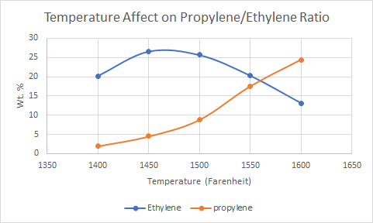
Rules for a Good Scientific Plot
Legends and curve labels
Generally the legend should be in the plot area, not outside the plot. If there are many lines though, it can be outside the plot area.
Labeling individual curves can be a good tool.

Slide 6
Rules for a Good Scientific Plot
Bad
Good

Slide 7
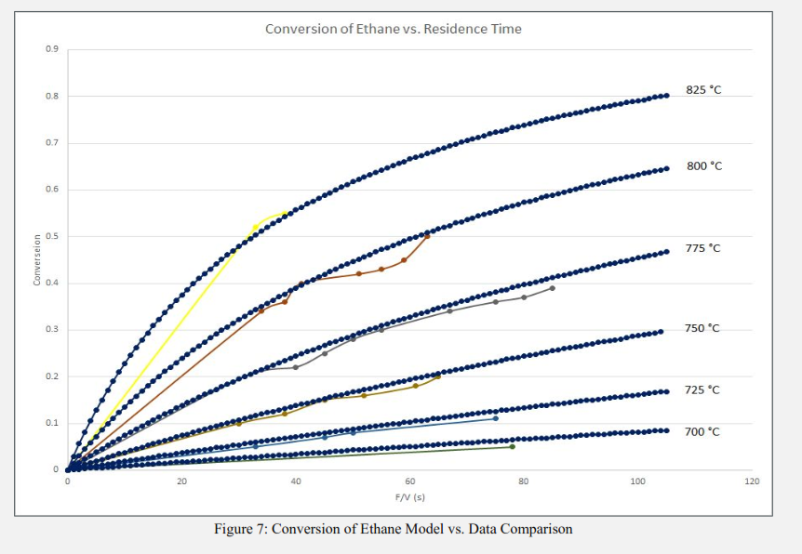
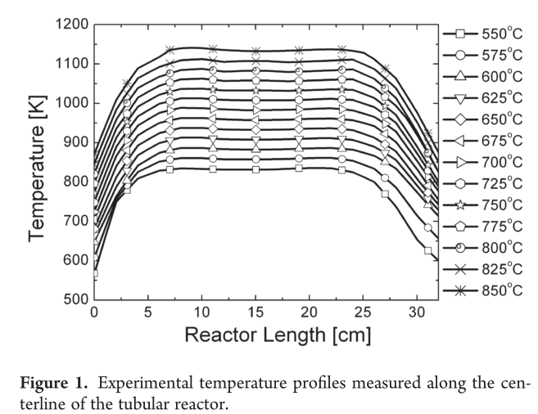
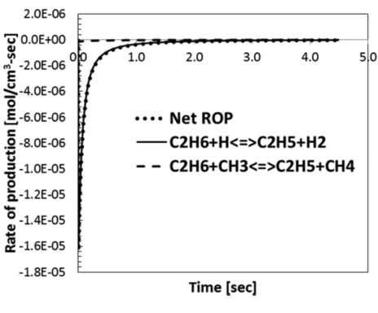
Rules for a Good Scientific Plot
Legends and curve labels
Generally the legend should be in the plot area, not outside the plot. If there are many lines though, it can be outside the plot area.
Labeling individual curves can be a good tool.
Saldana, M. H., et al. 2016. https://doi.org/10.1021/acs.energyfuels.6b01752
Xu, C., et al. 2011 https://doi.org/10.1021/jp206503d

Slide 8
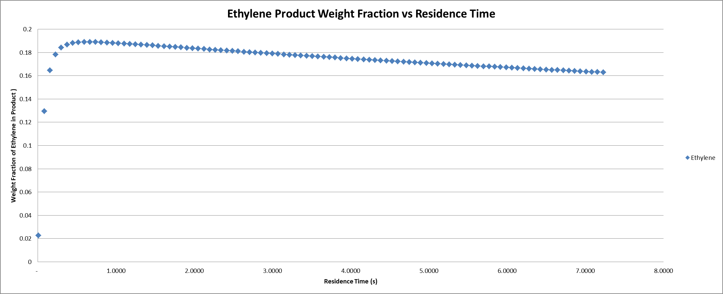
Rules for a Good Scientific Plot
Plot Area
Should generally be somewhat squarish. Can deviate a little to better fill space or better present data.
Remove plot border (not the border around the data area, but the light gray border excel puts around the plot when copied into word or power point).

Slide 9
Rules for a Good Scientific Plot

Slide 10
Rules for a Good Scientific Plot
Comparisons with other data sets
Comparisons should almost always be on the same plot.
You don’t have to have a legend entry for every line shown.
Split up if there are too many lines on a single plot for it to be readable.
Replot data from other sources, don’t just copy images. (DataThief)
Choose a consistent method of differentiation curves form different sources or under different conditions. (Dashed vs solid lines, open vs closed symbols, light vs dark, etc.)

Slide 11
Rules for a Good Scientific Plot
Comparisons with other data sets
Comparisons should almost always be on the same plot.
You don’t have to have a legend entry for every line shown.
Split up if there are too many lines on a single plot for it to be readable.
Replot data from other sources, don’t just copy images. (DataThief)
Choose a consistent method of differentiation curves form different sources or under different conditions. (Dashed vs solid lines, open vs closed symbols, light vs dark, etc.)

Slide 12
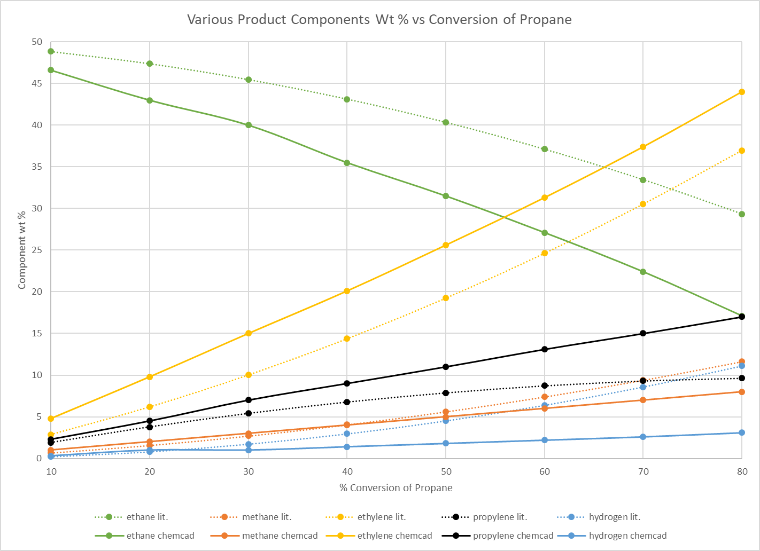
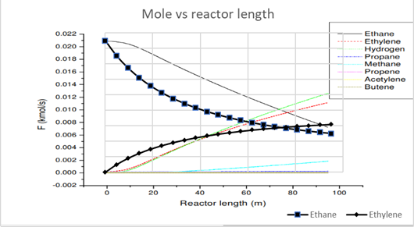
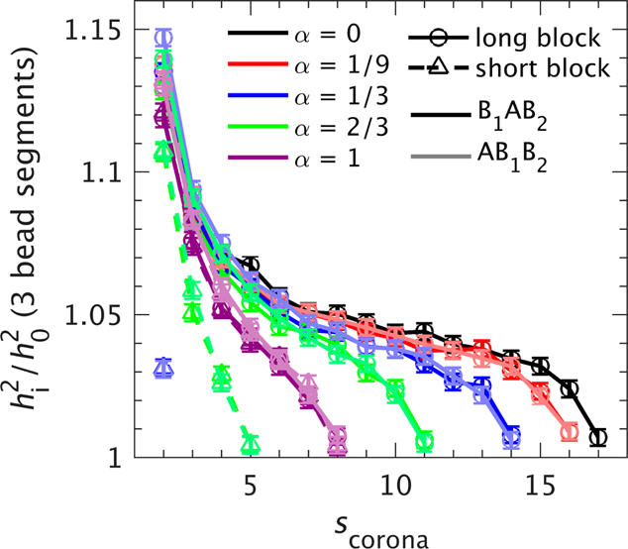
Rules for a Good Scientific Plot
Comparisons with other data sets
Comparisons should almost always be on the same plot.
You don’t have to have a legend entry for every line shown.
Split up if there are too many lines on a single plot for it to be readable.
Replot data from other sources, don’t just copy images. (DataThief)
Choose a consistent method of differentiation curves form different sources or under different conditions. (Dashed vs solid lines, open vs closed symbols, light vs dark, etc.)
Peters, A. J., & Lodge, T. P. (2017). https://doi.org/10.1021/acs.macromol.7b01046

Slide 13
Rules for a Good Scientific Plot
Comparisons with other data sets
Comparisons should almost always be on the same plot.
You don’t have to have a legend entry for every line shown.
Split up if there are too many lines on a single plot for it to be readable.
Replot data from other sources, don’t just copy images. (DataThief)
Choose a consistent method of differentiation curves form different sources or under different conditions. (Dashed vs solid lines, open vs closed symbols, light vs dark, etc.)
Peters, A. J., & Lodge, T. P. (2017). https://doi.org/10.1021/acs.macromol.7b01046

Slide 14
Rules for a Good Scientific Plot
Comparisons with other data sets
Comparisons should almost always be on the same plot.
You don’t have to have a legend entry for every line shown.
Split up if there are too many lines on a single plot for it to be readable.
Replot data from other sources, don’t just copy images. (DataThief)
Choose a consistent method of differentiation curves form different sources or under different conditions. (Dashed vs solid lines, open vs closed symbols, light vs dark, etc.)

Slide 15
Rules for a Good Scientific Plot
Colors and curve differentiation
Be consistent. (Don’t completely change your symbol or line style halfway through your list of curves without reason, use the same size symbols for everything).
Use filled and open symbols.
If filled, don’t use a different outline color.
(My preference). I think excel’s default colors are ugly. I like to go with a color scheme that goes black>red>blue>green>orange>purple. 6 colors is usually enough.
Yellow is often hard to read.
Be consistent with the meaning of each color or symbol type or line type.
If the lines are not simply connecting data points, then they should represent a smooth function (i.e. a fit, or an equation of some kind). Discrete data points should be plotted as points.

Slide 16
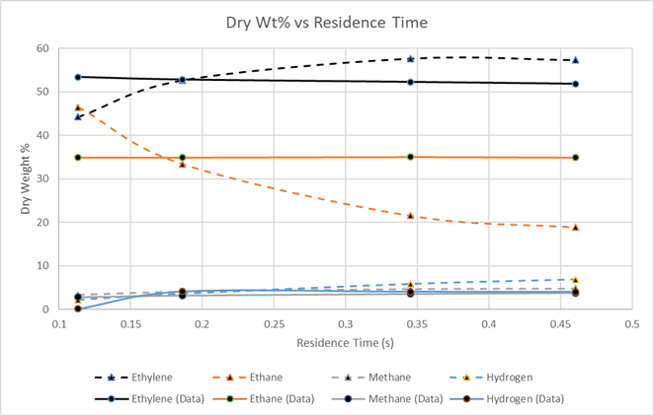
Rules for a Good Scientific Plot
Colors and curve differentiation
Be consistent. (Don’t completely change your symbol or line style halfway through your list of curves without reason, use the same size symbols for everything).
Use filled and open symbols.
If filled, don’t use a different outline color.
(My preference). I think excel’s default colors are ugly. I like to go with a color scheme that goes black>red>blue>green>orange>purple. 6 colors is usually enough.
Yellow is often hard to read.
Be consistent with the meaning of each color or symbol type or line type.
If the lines are not simply connecting data points, then they should represent a smooth function (i.e. a fit, or an equation of some kind). Discrete data points should be plotted as points.

Slide 17
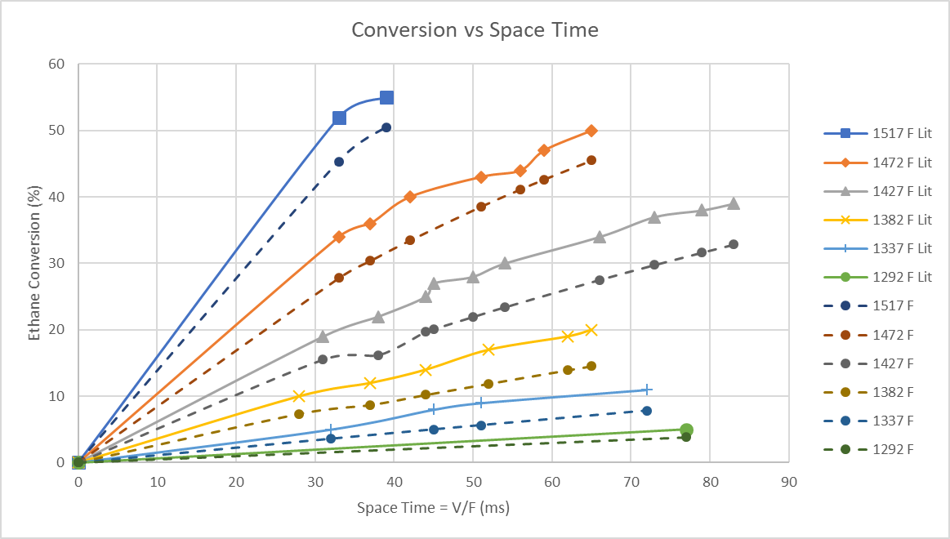
Rules for a Good Scientific Plot
Colors and curve differentiation
Be consistent. (Don’t completely change your symbol or line style halfway through your list of curves without reason, use the same size symbols for everything).
Use filled and open symbols.
If filled, don’t use a different outline color.
(My preference). I think excel’s default colors are ugly. I like to go with a color scheme that goes black>red>blue>green>orange>purple. 6 colors is usually enough.
Yellow is often hard to read.
Be consistent with the meaning of each color or symbol type or line type.
If the lines are not simply connecting data points, then they should represent a smooth function (i.e. a fit, or an equation of some kind). Discrete data points should be plotted as points.

Slide 18
Rules for a Good Scientific Plot

Slide 19
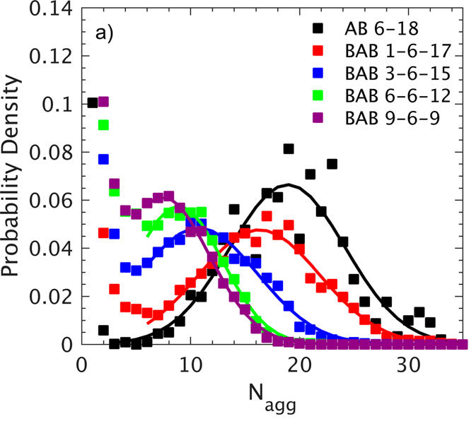
Rules for a Good Scientific Plot
Colors and curve differentiation
Be consistent. (Don’t completely change your symbol or line style halfway through your list of curves without reason, use the same size symbols for everything).
Use filled and open symbols.
If filled, don’t use a different outline color.
(My preference). I think excel’s default colors are ugly. I like to go with a color scheme that goes black>red>blue>green>orange>purple. 6 colors is usually enough.
Yellow is often hard to read.
Be consistent with the meaning of each color or symbol type or line type.
If the lines are not simply connecting data points, then they should represent a smooth function (i.e. a fit, or an equation of some kind). Discrete data points should be plotted as points.
Peters, A. J., & Lodge, T. P. (2017). https://doi.org/10.1021/acs.macromol.7b01046

Slide 20
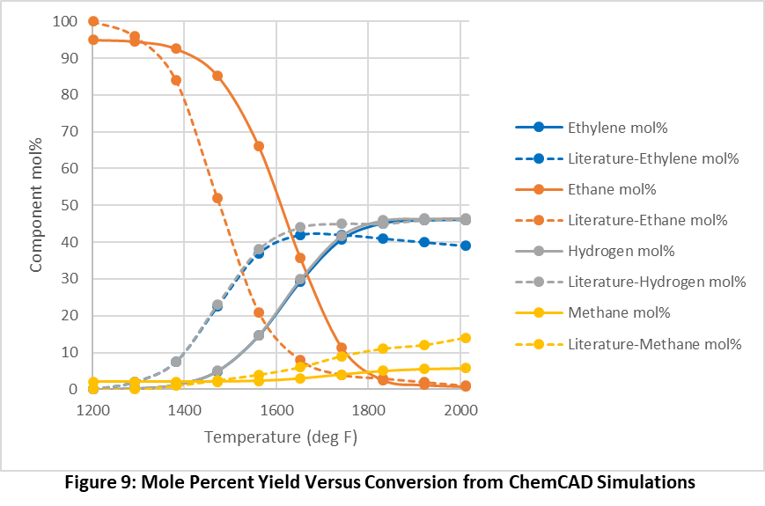
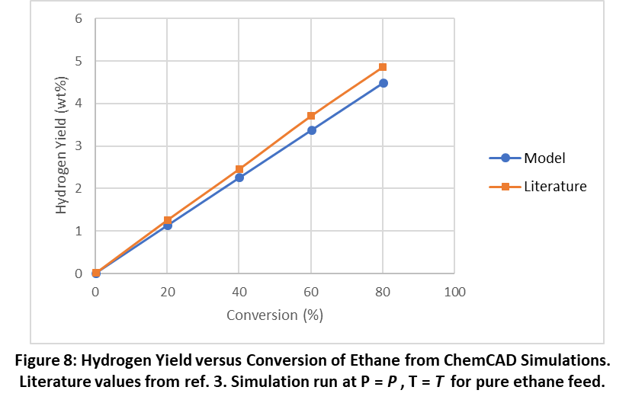
Rules for a Good Scientific Plot
Captions and Titles
In reports, captions are not optional and should be descriptive but not very interpretive. Presentation should generally not include captions. Give conditions of the data shown (T, P, flow rate, whatever else is relevant). Titles are optional.
Include a citation for any data plotted that you did not generate in the caption for a report, or near the plot (or in the bottom corner of the slide) in a presentation.
Figure 8: Hydrogen Yield versus Conversion of Ethane from ChemCAD Simulations.
Literature values from ref. 3. Simulation run at P = P , T = T for pure ethane feed.
T = T, P = P, pure ethane feed.
Lit. values from Author et al. 2018. http://doi.org/111
Figure 9: Mole Percent Yield Versus Conversion from ChemCAD Simulations

Slide 21
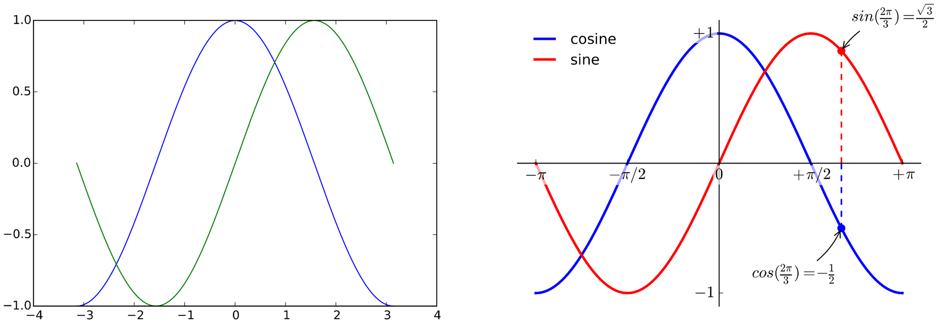
Rules for a Good Scientific Plot
Be consistent!
Don’t trust defaults!
Make your plot as understandable as possible with as little effort as possible.
Excel Defaults
Matplotlib Defaults
Rougier NP, et al. 2014. https://doi.org/10.1371/journal.pcbi.1003833
Improved
Rougier NP, et al. 2014. https://doi.org/10.1371/journal.pcbi.1003833
Saldana, M. H., et al. 2016. https://doi.org/10.1021/acs.energyfuels.6b01752

Slide 22
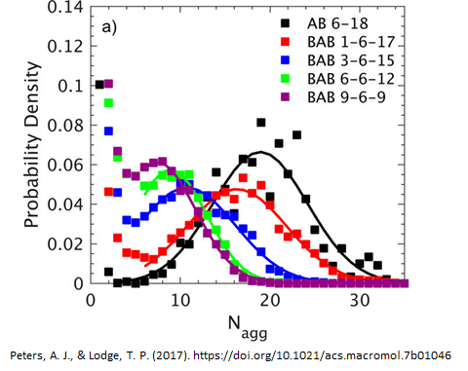
Rules for a Good Scientific Plot
Be consistent!
Don’t trust defaults!
Make your plot as understandable as possible with as little effort as possible.
Saldana, M. H., et al. 2016. https://doi.org/10.1021/acs.energyfuels.6b01752
Xu, C., et al. 2011 https://doi.org/10.1021/jp206503d

Slide 24
Rules for a Good Scientific Plot
Be consistent!

Slide 25
Rules for a Good Scientific Plot

Slide 27
Rules for a Good Scientific Plot
Axis Labels
Axis tick marks and tick labels
Legends and curve labels
Plot Area
Comparisons with other data sets
Colors and curve differentiation
Be consistent!
In reports, captions are not optional and should be descriptive but not very interpretive. Presentation should generally not include captions.
Titles are optional.
Include a citation for any data plotted that you did not generate in the caption for a report, or near the plot (or in the bottom corner of the slide) in a presentation.
Don’t trust defaults!
Make your plot as understandable as possible with as little effort as possible.

Slide 29
1. All text must be legible and properly formatted.

Slide 32
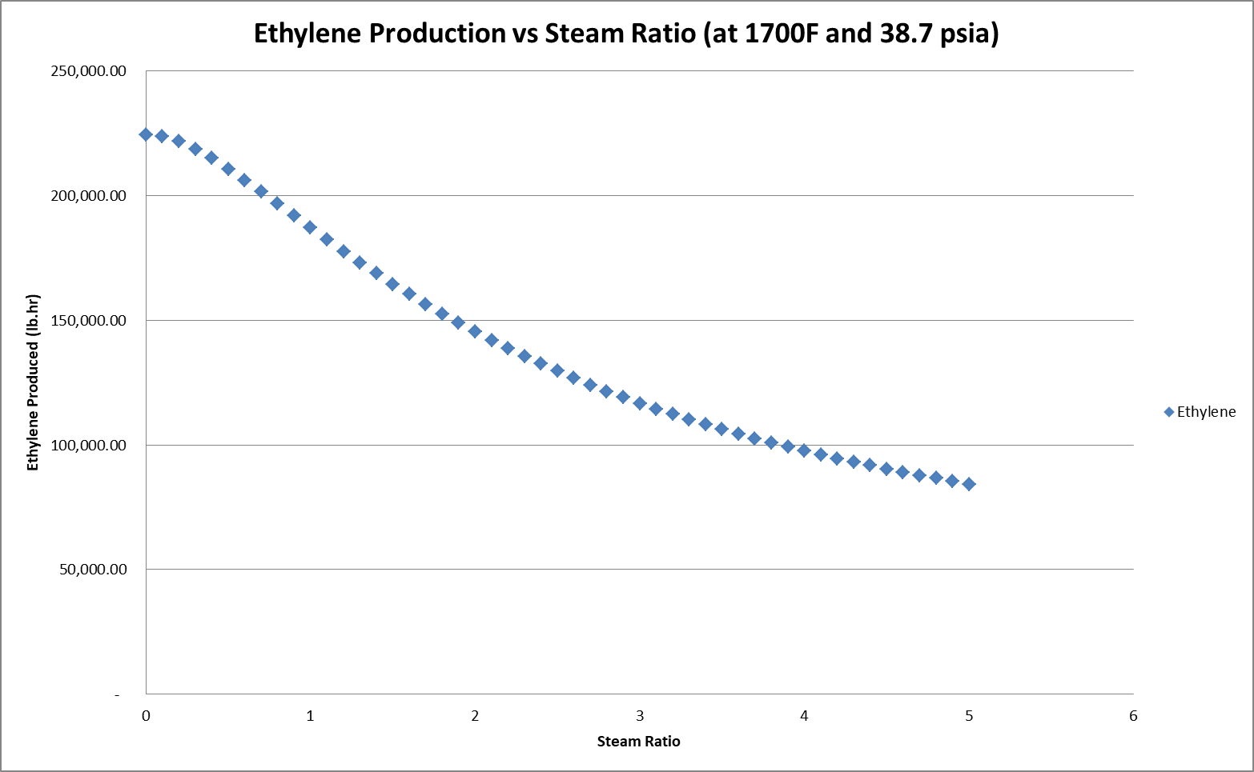
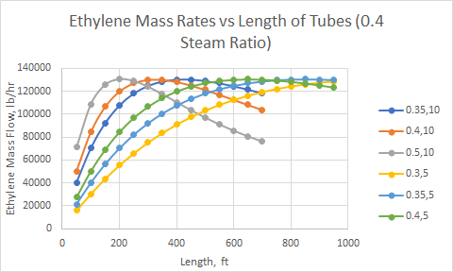
Note (Legend of Graphs): (a,b) = (tube diameter (ft), number of tubes)

Slide 35
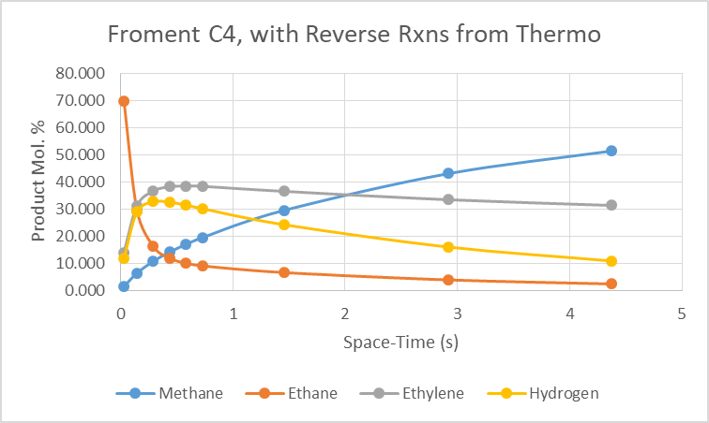

Slide 37
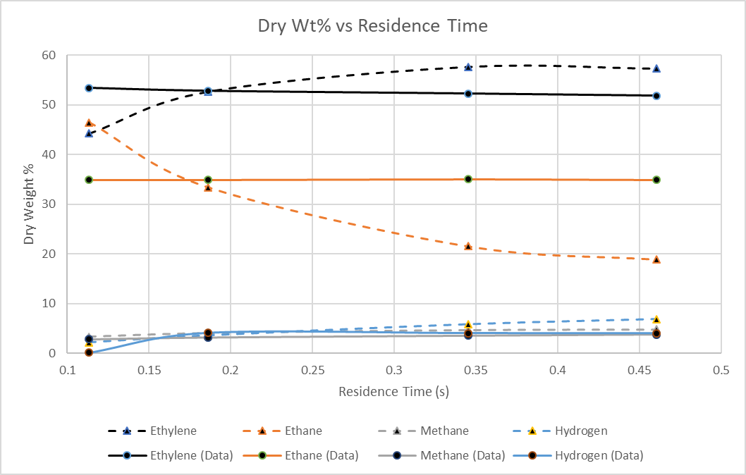

Slide 38
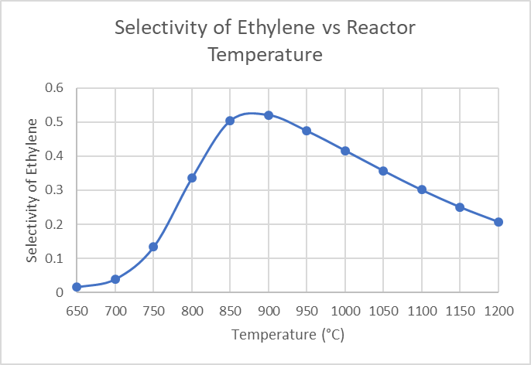

Slide 39
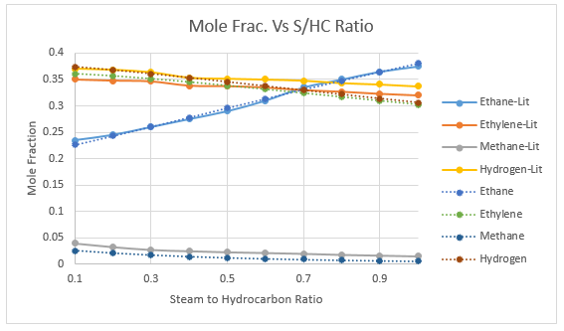

Slide 44
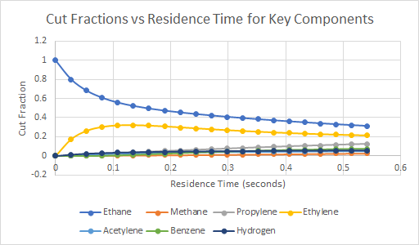

Slide 47
Rules for a Good Scientific Plot
Colors and curve differentiation
Be consistent. (Don’t completely change your symbol or line style halfway through your list of curves without reason, use the same size symbols for everything).
Use filled and open symbols.
If filled, don’t use a different outline color.
(My preference). I think excel’s default colors are ugly. I like to go with a color scheme that goes black>red>blue>green>orange>purple. 6 colors is usually enough.
Yellow is often hard to read.
Be consistent with the meaning of each color or symbol type or line type.
If the lines are not simply connecting data points, then they should represent a smooth function (i.e. a fit, or an equation of some kind). Discrete data points should be plotted as points.

